Slide 1
Strings in c

Slide 2
Strings
In C programming, array of character are called strings.
A string is terminated by null character /0.
For example:
"c string tutorial"
Here, "c string tutorial" is a string.
When, compiler encounters strings, it appends null character at the end of string.

Slide 3

Declaration of strings
Strings are declared in C in similar manner as arrays.
Only difference is that, strings are of char type.
char s[5];

Slide 4

Initialization of strings
In C, string can be initialized in different number of ways.
char c[]="abcd";
OR,
char c[5]="abcd";
OR,
char c[]={'a','b','c','d','\0'};
OR;
char c[5]={'a','b','c','d','\0'};

Slide 5
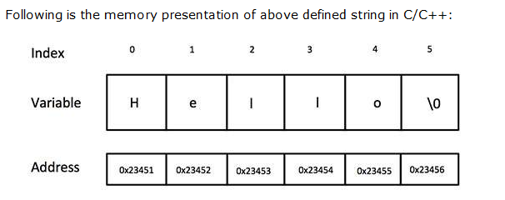
char greeting[6] = {'H', 'e', 'l', 'l', 'o', '\0'};
If you follow the rule of array initialization then you can write the above statement as follows:
char greeting[] = "Hello";

Slide 6
string in/output:
scanf("%s",&S);
printf("%s",S);
Reading words from user.
char c[20];
scanf("%s",c);
String variable c can only take a word using scanf().
It is because when white space is encountered, the scanf() function terminates.

Slide 7
Write a C program to illustrate how to read string from terminal.
#include <stdio.h>
int main(){
char name[20];
printf("Enter name: ");
scanf("%s",name);
printf("Your name is %s.",name);
return 0;
}

Slide 8
Output
Enter name: Dennis Ritchie
Your name is Dennis.
Here, program will ignore Ritchie because,
scanf() function takes only string before the white space.

Slide 9
Reading a line of text
C program to read line of text manually.
#include <stdio.h>
int main(){
char name[30],ch;
int i=0;
printf("Enter name: ");
while(ch!='\n') // terminates if user hit enter
{
ch=getchar();
name[i]=ch;
i++;
}
name[i]='\0'; // inserting null character at end
printf("Name: %s",name);
return 0;
}

Slide 10
This process to take string is tedious. There are predefined functions gets() and puts in C language to read and display string respectively.
#include<stdio.h>
int main(){
char name[30];
printf("Enter name: ");
gets(name); //Function to read string from user.
printf("Name: ");
puts(name); //Function to display string.
return 0;
}

Slide 11
Both, the above program has same output below:
Output
Enter name: Tom Hanks
Name: Tom Hanks

Slide 12
Passing Strings to Functions
String can be passed to function in similar manner as arrays as, string is also an array.
#include <stdio.h>
void Display(char ch[]);
int main(){
char c[50];
printf("Enter string: ");
gets(c);
Display(c); // Passing string c to function.
return 0;
}
void Display(char ch[]){
printf("String Output: ");
puts(ch);
}
Here, string c is passed from main() function to user-defined function Display().
In function declaration, ch[] is the formal argument.

Slide 13
String handling functions
You can perform different type of string operations manually like: finding length of string, concatenating(joining) two strings etc.
But, for programmers ease, many library function are defined under header file <string.h> to handle these commonly used talk in C programming.
Strings are often needed to be manipulated by programmer according to the need of a problem.
All string manipulation can be done manually by the programmer but, this makes programming complex and large.
To solve this, the C supports a large number of string handling functions.

Slide 14
Range of functions that manipulate null-terminated strings:
1 strcpy(s1, s2);
Copies string s2 into string s1.
2 strcat(s1, s2);
Concatenates string s2 onto the end of string s1.
3 strlen(s1);
Returns the length of string s1.
4 strcmp(s1, s2);
Returns 0 if s1 and s2 are the same; less than 0 if s1<s2; greater than 0 if s1>s2.
5 strchr(s1, ch);
Returns a pointer to the first occurrence of character ch in string s1.
6 strstr(s1, s2);
Returns a pointer to the first occurrence of string s2 in string s1.

Slide 15
#include <stdio.h>
#include <string.h>
int main ()
{
char str1[12] = "Hello";
char str2[12] = "World";
char str3[12];
int len ;
/* copy str1 into str3 */
strcpy(str3, str1);
printf("strcpy( str3, str1) : %s\n", str3 );
/* concatenates str1 and str2 */
strcat( str1, str2);
printf("strcat( str1, str2): %s\n", str1 );
/* total lenghth of str1 after concatenation */
len = strlen(str1);
printf("strlen(str1) : %d\n", len );
return 0;
}

Slide 16
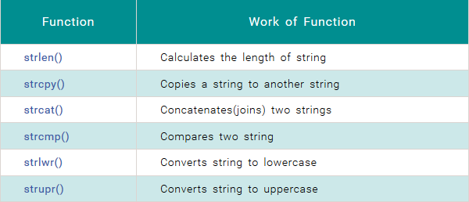

Slide 17
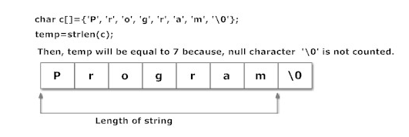
strlen()
In C, strlen() function calculates the length of string. It takes only one argument, i.e, string name.
Syntax of strlen()
temp_variable = strlen(string_name);
Function strlen() returns the value of type integer.

Slide 18
Example of strlen()
#include <stdio.h>
#include <string.h>
int main(){
char a[20]="Program";
char b[20]={'P','r','o','g','r','a','m','\0'};
char c[20];
printf("Enter string: ");
gets(c);
printf("Length of string a=%d \n",strlen(a));
//calculates the length of string before null charcter.
printf("Length of string b=%d \n",strlen(b));
printf("Length of string c=%d \n",strlen(c));
return 0;
}

Slide 19
Output
Enter string: String
Length of string a=7
Length of string b=7
Length of string c=6

Slide 20
strcpy()
Function strcpy() copies the content of one string to the content of another string. It takes two arguments.
Syntax of strcpy()
strcpy ( destination , source);
Here, source and destination are both the name of the string.
This statement, copies the content of string source to the content of string destination.

Slide 21
Example of strcpy()
#include <stdio.h>
#include <string.h>
int main(){
char a[10],b[10];
printf("Enter string: ");
gets(a);
strcpy(b,a); //Content of string a is copied to string b.
printf("Copied string: ");
puts(b);
return 0;
}

Slide 22
Output
Enter string: Programming Tutorial
Copied string: Programming Tutorial

Slide 23
strcat()
In C programming, strcat() concatenates(joins) two strings. It takes two arguments,
i.e, two strings and resultant string is stored in the first string specified in the argument.
Syntax of strcat()
strcat (first_string , second_string);

Slide 24
Example of strcat()
#include <stdio.h>
#include <string.h>
int main(){
char str1[]="This is ", str2[]=“England";
strcat(str1,str2);
//concatenates str1 and str2 and resultant string is stored in str1.
puts(str1);
puts(str2);
return 0;
}

Slide 25
Output
This is England
England

Slide 26
strcmp()
In C programming, strcmp() compares two string and returns value 0, if the two strings are equal.
Function strcmp() takes two arguments, i.e, name of two string to compare.
Syntax of strcmp()
temp_varaible= strcmp( string1, string2);

Slide 27
Example of strcmp()
#include <stdio.h>
#include <string.h>
int main(){
char str1[30],str2[30];
printf("Enter first string: ");
gets(str1);
printf("Enter second string: ");
gets(str2);
if(strcmp(str1,str2)==0)
printf("Both strings are equal");
else
printf("Strings are unequal");
return 0;
}

Slide 28
output
Enter first string: Apple
Enter second string: Apple
Both strings are equal.
If two strings are not equal, strcmp() returns positive value
if ASCII value of first mismatching element of first string is greater than that of second string and
negative value if ASCII value of first mismatching element of first string is less than that of second string.
For example:
char str1[]="and",str2[]="cat";
temp=strcmp(str1,str2);
Since, ASCII value of 'a' is less than that of 'c', variable temp will be negative

Slide 29
strlwr()
In C programming, strlwr() function converts all the uppercase characters in that string to lowercase characters.
The resultant from strlwr() is stored in the same string.
Syntax of strlwr()
strlwr (string_name);

Slide 30
Example of strlwr()
#include <stdio.h>
#include <string.h>
int main(){
char str1[]="LOWer Case";
puts(strlwr(str1)); //converts to lowercase and displays it.
return 0;
}
Output
lower case
Function strlwr() leaves the lowercase characters as it is and converts uppercase characters to lowercase.

Slide 31
strupr()
In C programming, strupr() function converts all the lowercase characters in that string to uppercase characters.
The resultant from strupr() is stored in the same string.
Syntax of strupr()
strupr (string_name);

Slide 32
Example of strupr()
#include <stdio.h>
#include <string.h>
int main(){
char str1[]="UppEr Case";
puts(strupr(str1)); //Converts to uppercase and displays it.
return 0;
}
Output
UPPER CASE
Function strupr() leaves the uppercase characters as it is and converts lowercase characters to uppercase.

